Slide 1




CCI, UNC-Charlotte
User-friendly NPS-based recommender system for driving business revenue.
presented by
Zbigniew W. Ras
Research sponsored by

Slide 2

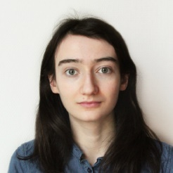
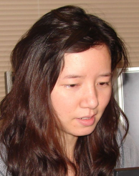


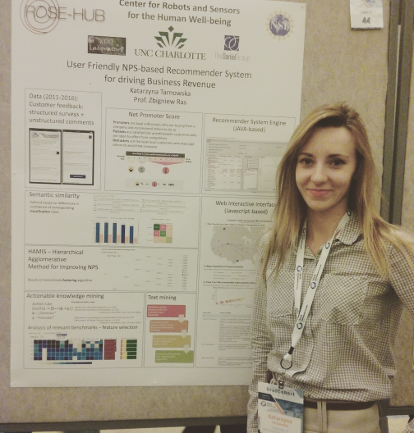

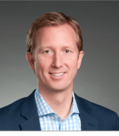


Project Team
KDD Lab Members
Kasia Tarnowska
(Warsaw Univ. of
Tech., Poland)
Pauline Brunet
(Paris Tech.,
France)
Jieyan Kuang
(Beijing Normal Univ., China)
Z.W.Ras
Industry Collaborators
Lynn Daniel
Doug Fowler
Kasia at NSF ROSE HUB Meeting

Slide 3
CLIRS -
Customer Loyalty Improvement Recommender System
Research sponsored by
Funding
(2013-current)

Slide 4


Consulting Company
What we had to do
Build
Recommender System
for each client
(34 clients) helping to
increase its revenue
Client 1
Client 2
Client 3
Client 4
shops
shops
shops
Build Personalized
Recommender System
for each shop helping to
increase its revenue
Services
(heavy equipment repair)
Parts
CUSTOMERS

Slide 5
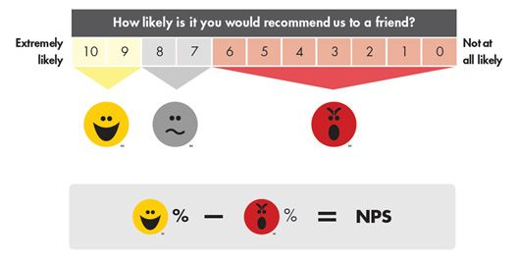
NPS is correlated with company revenue growth
Net Promoter Score (NPS) –
today’s standard for measuring customer loyalty
Promoter - {9,10}
Passive – {8,7}
Detractor – {1,2,3…,6}

Slide 6
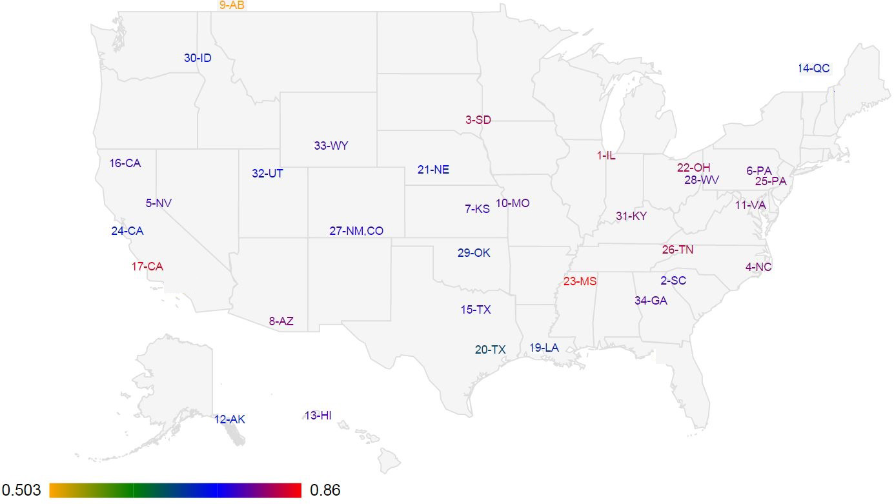
NPS rating for all clients

Slide 7
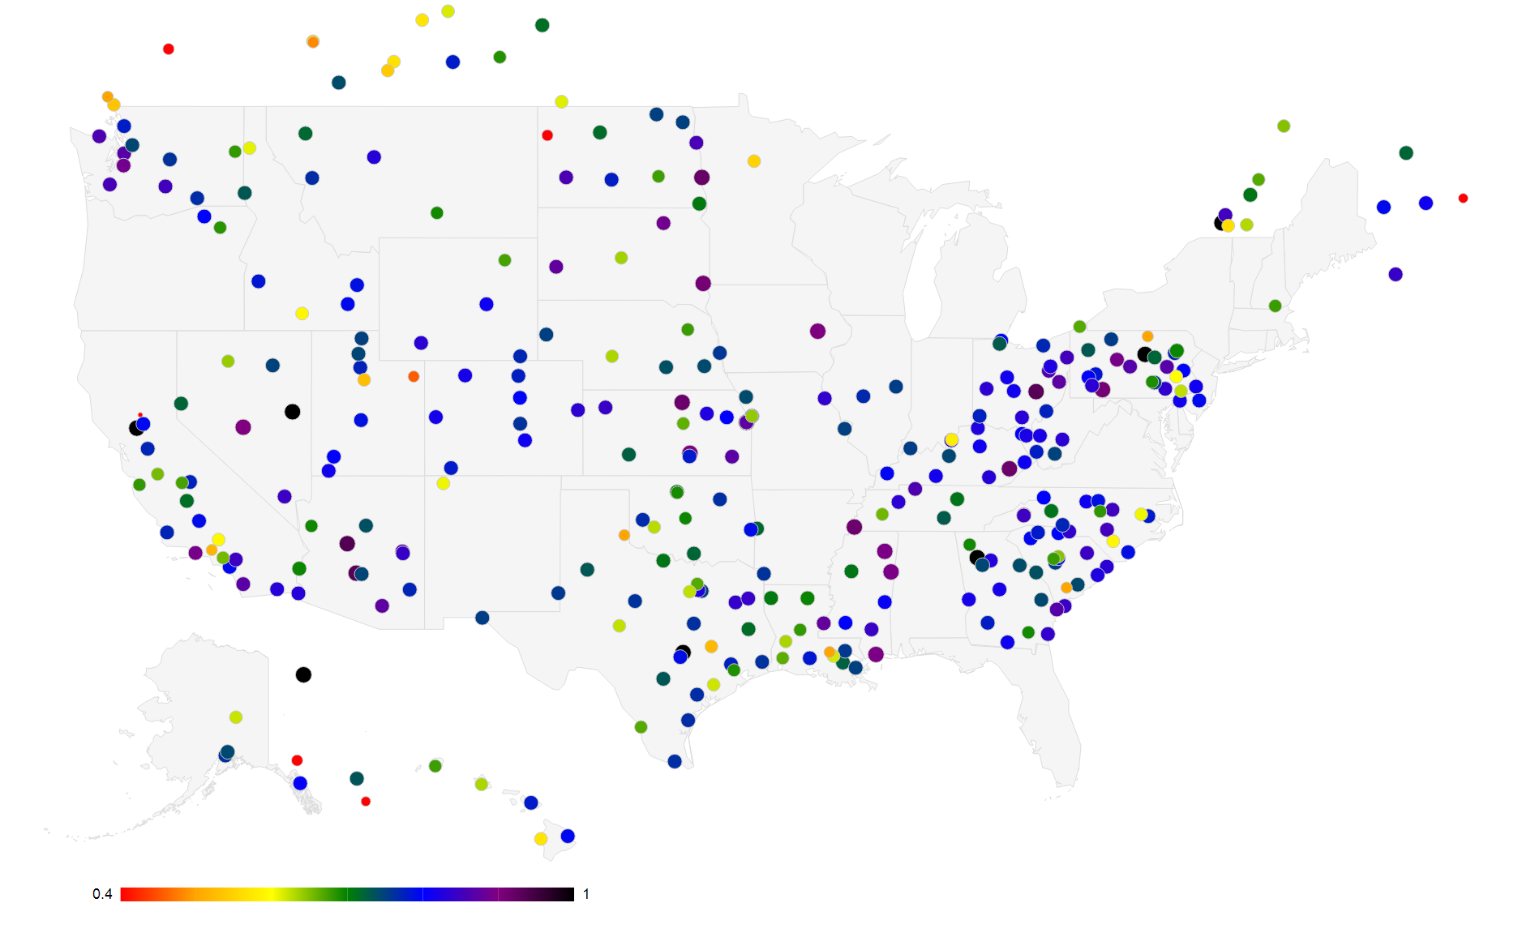
NPS rating for all shops

Slide 8
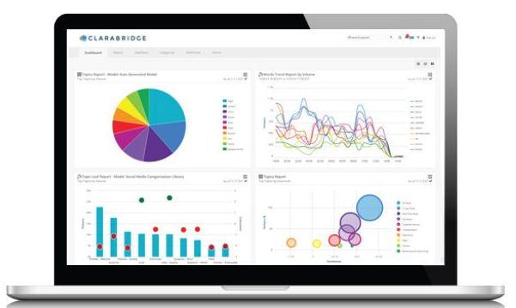
Clarabridge CX Analytics [http://www.clarabridge.com/]
Key Features:
Deep Natural Language Processing (NLP) - Accurately analyze mountains of unstructured data to
zero in on aspects of business that drive customers’ dissatisfaction.
Linguistic categorization - Intelligently groups customer comments into topic buckets for smarter analysis.
Emotion detection - Decipher the emotional state of customers based on the tone of the feedback.
Context-sensitive sentiment analysis - Understands the intensity of feelings expressed by using deep
Natural Language Processing, adjusting for industry and source-specific nuances.
Advanced discovery tools - Get to the core of customer issues using single click root cause analysis;
unearth previously unknown topics using fully automated topic detection engine.
Speech analytics – Capture customer’s voice, literally, by analyzing call recordings in the same
platform as all your other data sources.
• Does not discover
actionable knowledge
• Data analytics does not
provide any recommendations
which guarantee NPS improvement
TATA Company: collects not only customers text data but also voice & video

Slide 9
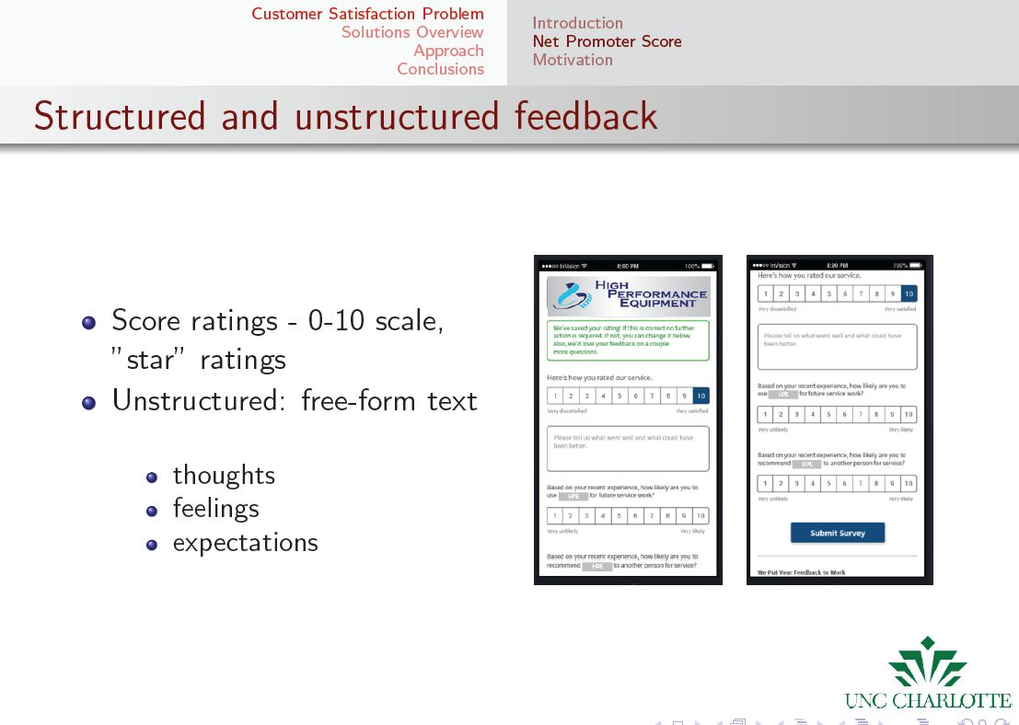
CLIRS
Our System

Slide 10
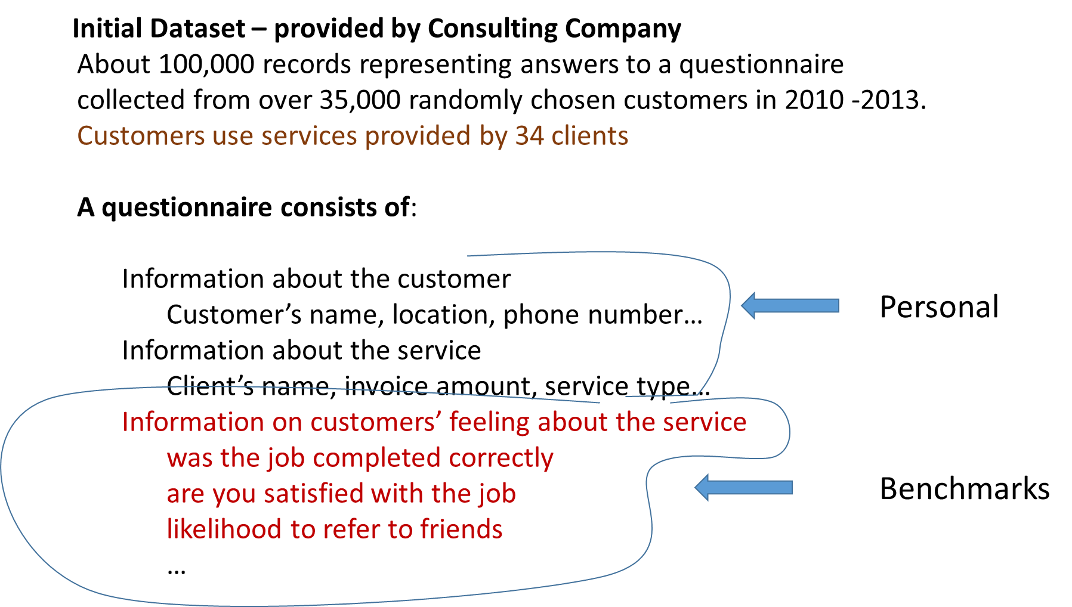
Currently ~ sampling of
300,000 records per year
2010-2016

Slide 11
Decision Table built from customers survey
Customer | M/F | Phone | Bench1 | Bench2 | Bench3 | Comments | Promoter Status
2011 | M |  | 3 | 9 | 5 | text1 | Promoter
2012 | M |  | 8 | 10 | 8 | text2 | Promoter
2013 | F |  | 8 | 5 | 8 | text3 | Detractor
2014 | F |  | 5 | 7 | 7 | text4 | Passive
New attributes can be derived
Text Mining & Sentiment Mining
can be used to build new attributes

Slide 12
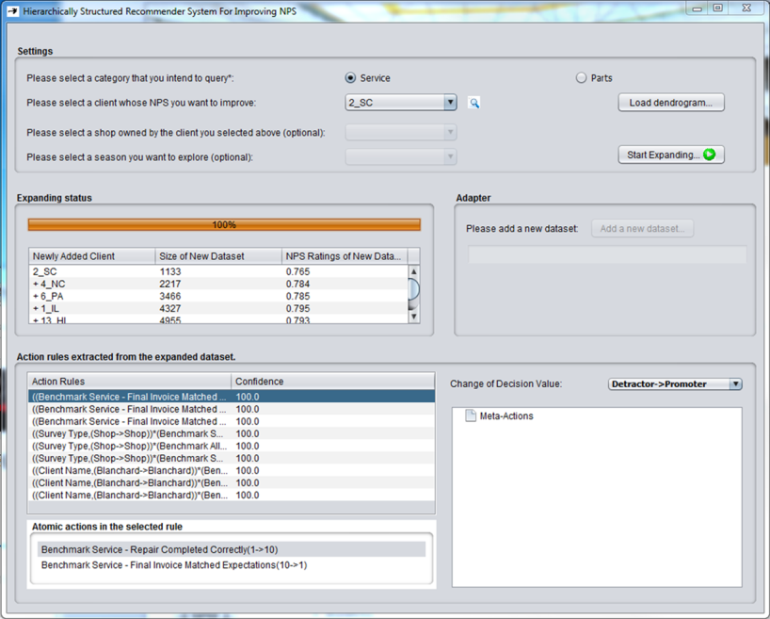
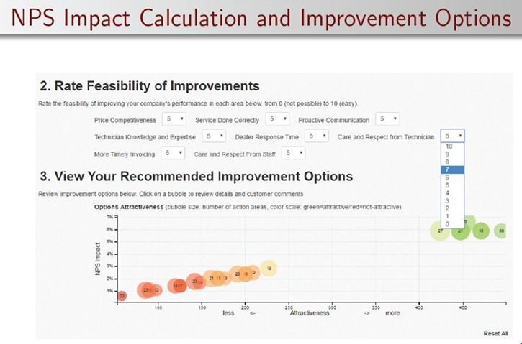
TUTORIAL: PLAN FOR TODAY’s PRESENTATION
CLIRS - Customer Loyalty Improvement Recommender System
Definitions/Concepts needed to understand how CLIRS is built & works:
Reducts in Decision Systems
Action Rules and Meta-Actions
Decision Tables & Their Semantic Similarity

Slide 13
Decision System - Granules
Promoter
Bench1 Bench2 Promoter Status
x１ a1 b2 promoter
x2 a1 b1 passive
x3 a2 b3 passive
x4 a2 b3 promoter
x5 a3 b4 passive
x6 a1 b4 promoter
x7 a3 b4 passive
Decision Granules:
{x1,x4,x6}, {x2,x4,x6}
Classification Granules:
Bench1: {x1,x2,x6}, {x3,x4}, {x5,x7}
Bench2: {x1},{x2},{x3,x4},{x5,x6,x7}
Smallest Granules:
{x1},{x2},{x3,x4},{x5,x7},{x6}
Passive
{x2}, {x5,x7}
Passive
{x3,x4}
{x1}, {x6}
Promoter/Passive
Informal Definition:
Reduct – smallest subset
of classification attributes
which preserves distribution
of objects in Figure 1
Promoter
Figure 1
?

Slide 14
Decision System & Reducts (Rough Sets)
Reduct1 = {Muscle-pain,Temp.}
Reduct2 = {Headache, Temp.}
We are looking for rules describing
Flu in terms of Headache, Muscle Pain, Temp.

Slide 15
ACTION RULES & META ACTIONS
Action Rules Miner:
Action4ft-Miner module in LISP Miner
http://lispminer.vse.cz/procedures/index.php?system=Ac4ftMiner
[developed by Jan Rauch (Univ. of Economics, Prague, Czech Republic]
Meta Action Miners: Only Domain Specific
(parts of domain specific software)
Triggers of Action Rules

Slide 16
Coming back to our customers feedback dataset
Rough Set REDUCTS have been used to identify features having the strongest impact on Promoter
Benchmark All Overall Satisfaction | 35
Benchmark All Likelihood to be Repeat Customer | 34
Benchmark All Dealer Communication | 33
Benchmark Service Repair Completed Correctly | 32
Benchmark Referral Behavior | 31
Benchmark Service Final Invoice Matched Expectations | 31
Benchmark Ease of Contact | 30
Benchmark All Does Customer have Future Needs | 28
Benchmark Service Tech Promised in Expected Timeframe | 26
Benchmark Service Repair Completed When Promised | 26
Benchmark Service Timeliness of Invoice | 25
Benchmark Service Appointment Availability | 24
Benchmark Service Tech Equipped to do Job | 23
Benchmark All Contact Status of Future Needs | 22
Benchmark Service Tech Arrived When Promised | 21
Benchmark All Has Issue Been Resolved | 19
Benchmark All Contact Status of Issue | 17
Benchmark Service Technician Communication | 6
Benchmark Service Contact Preference | 3
Benchmark CB Call answered promptly | 1
Benchmark Service Received Quote for Repair | 1
Benchmark CB Auto attendant answered by correct department | 1
Benchmark Service Call Answered Quickly | 1
Benchmark All Marketing Permission | 1
Randomly chosen customers are
asked to complete Questionnaire.
It has questions concerning
personal data + 30 benchmarks
To compute NPS we calculate average score
of selected benchmarks for all customers.
Knowing the number of promoters and
detractors we know NPS.

Slide 17
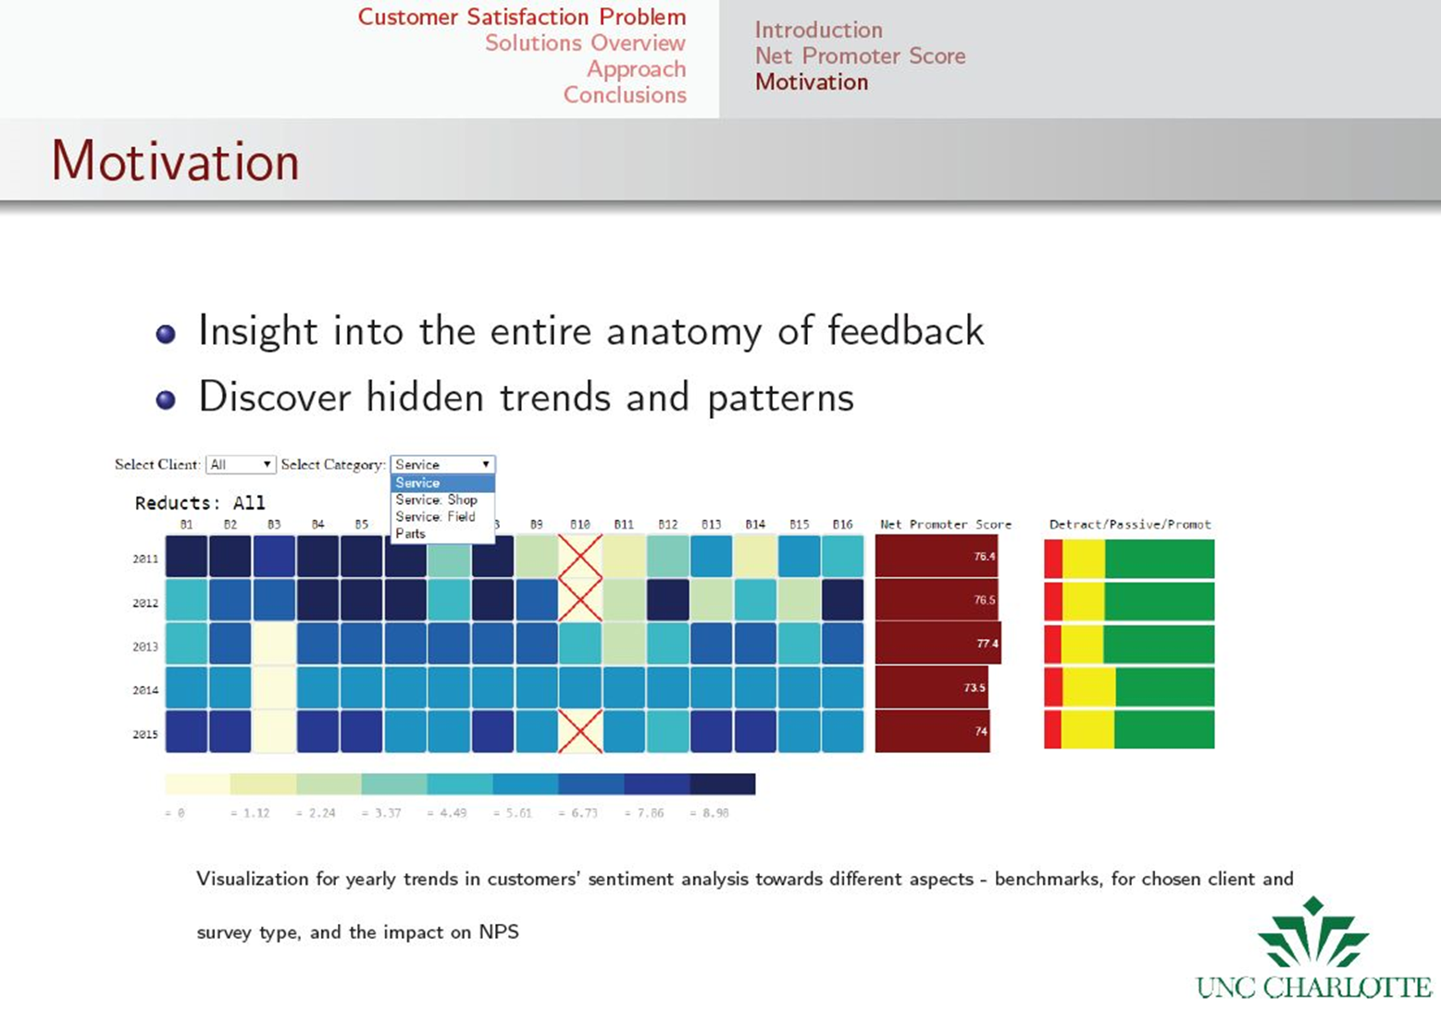

Slide 18
RECOMMENDER SYSTEM CLIRS
based on semantic extension of a client dataset
created by adding datasets of other semantically similar clients

Slide 19
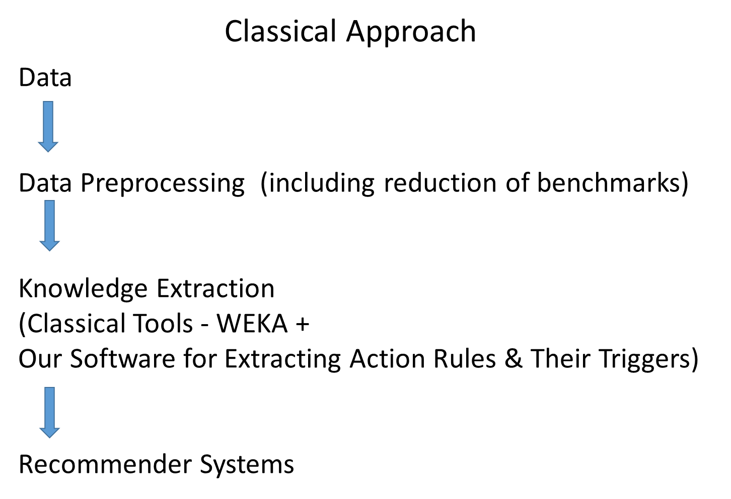


Slide 20
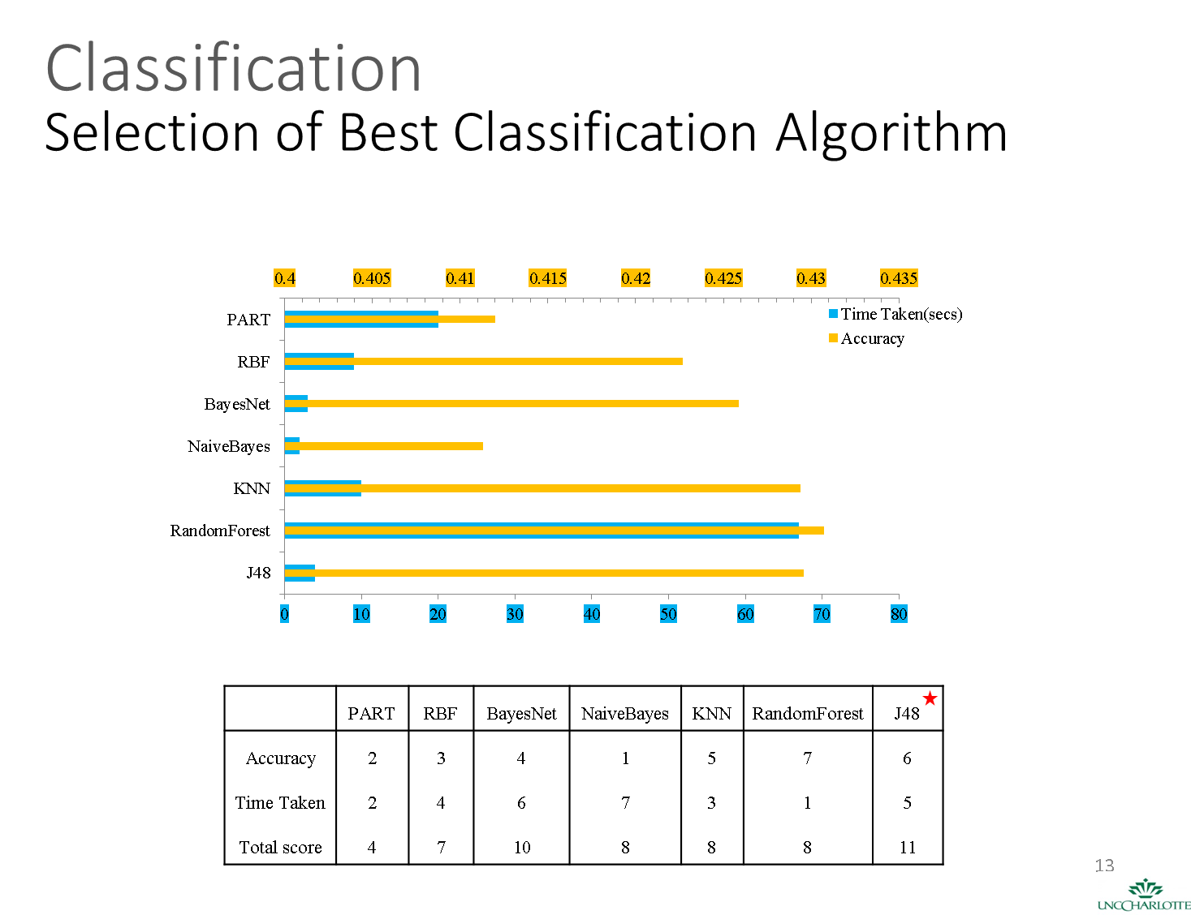

Slide 21
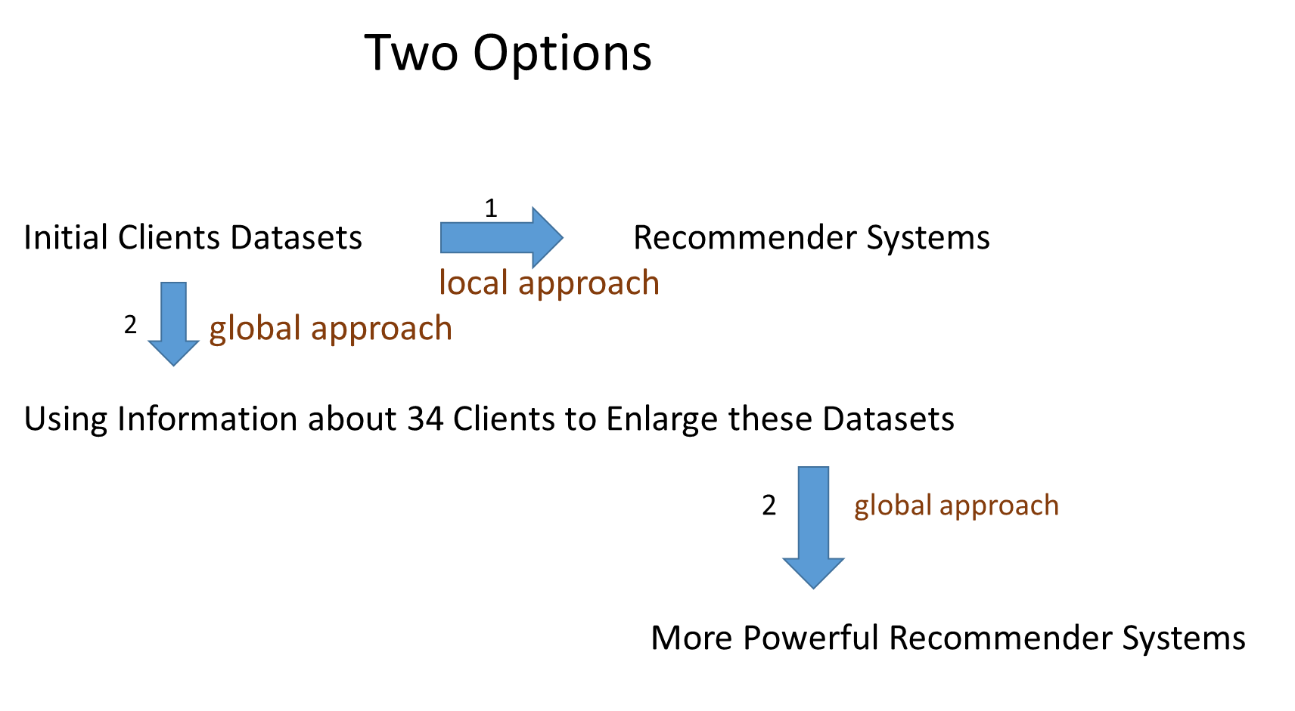

Slide 22
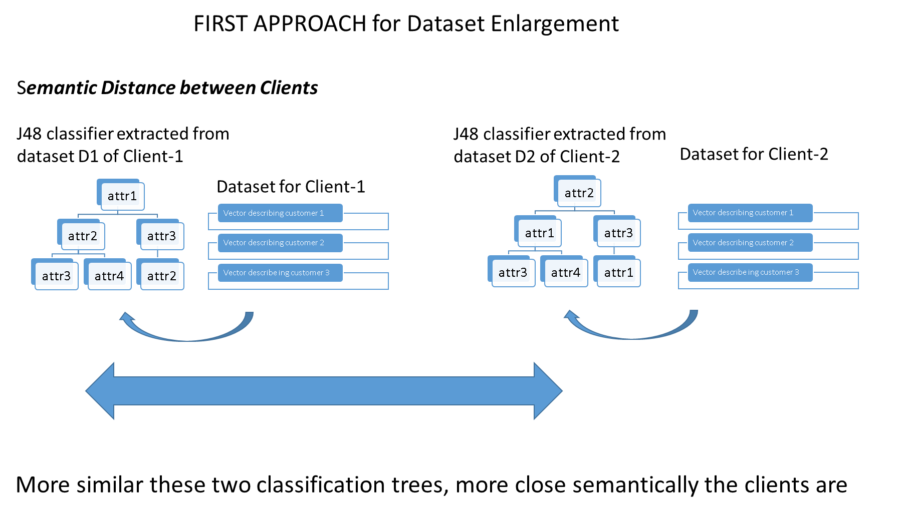

Slide 23
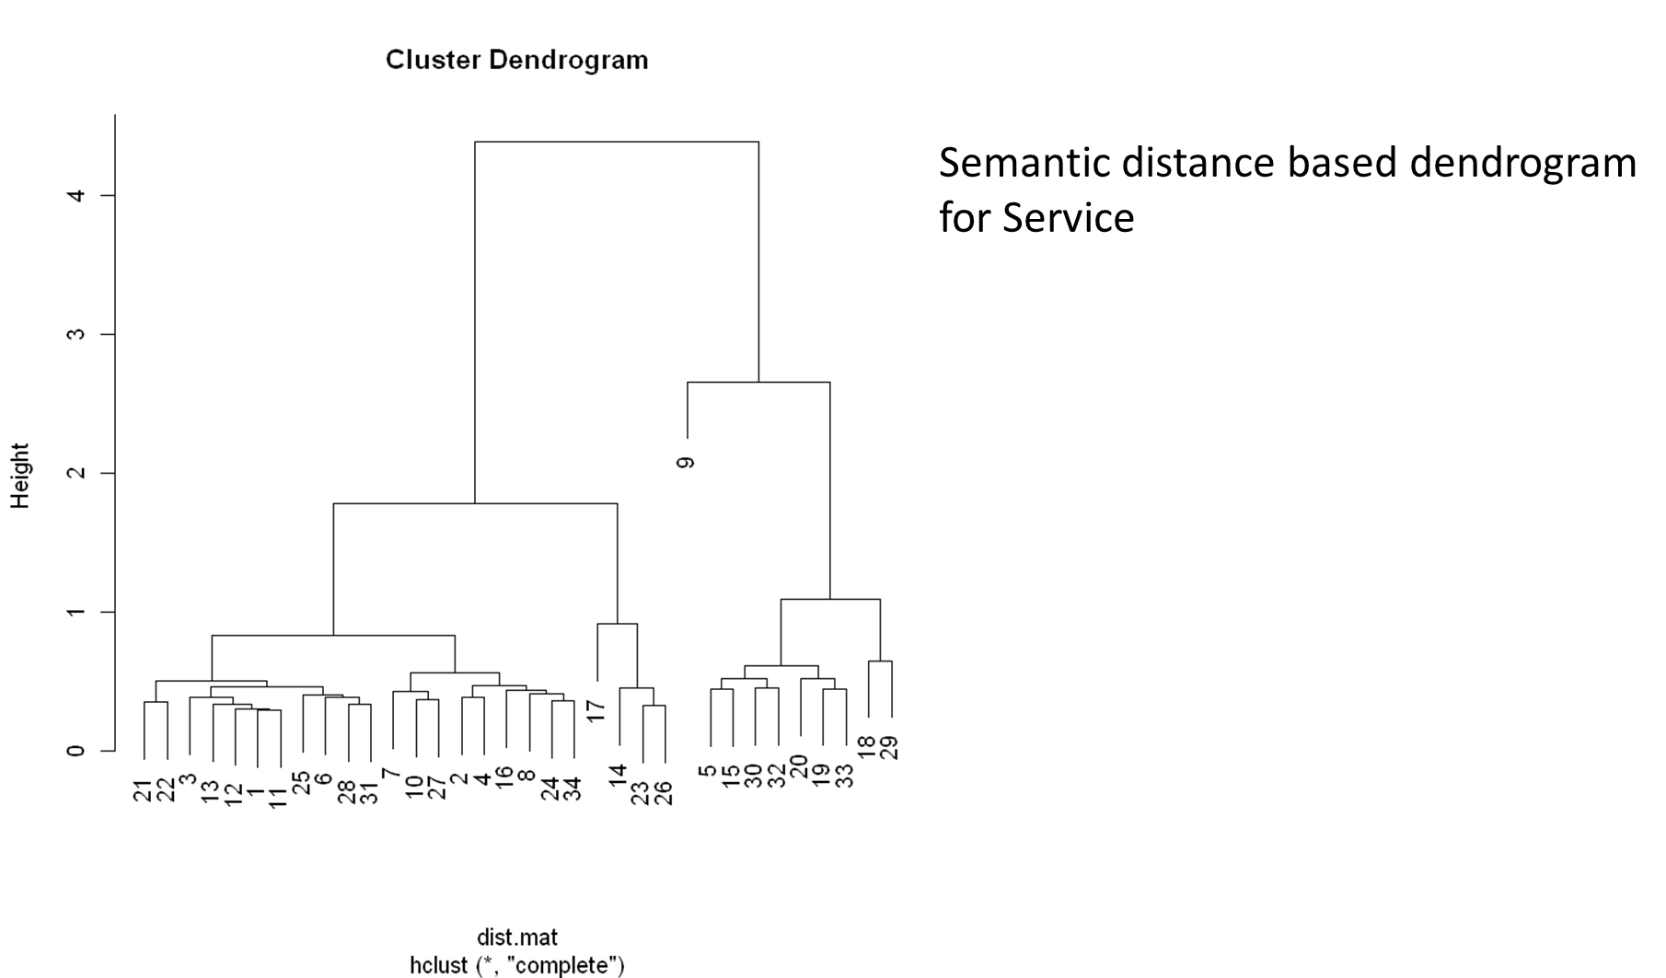

Slide 24
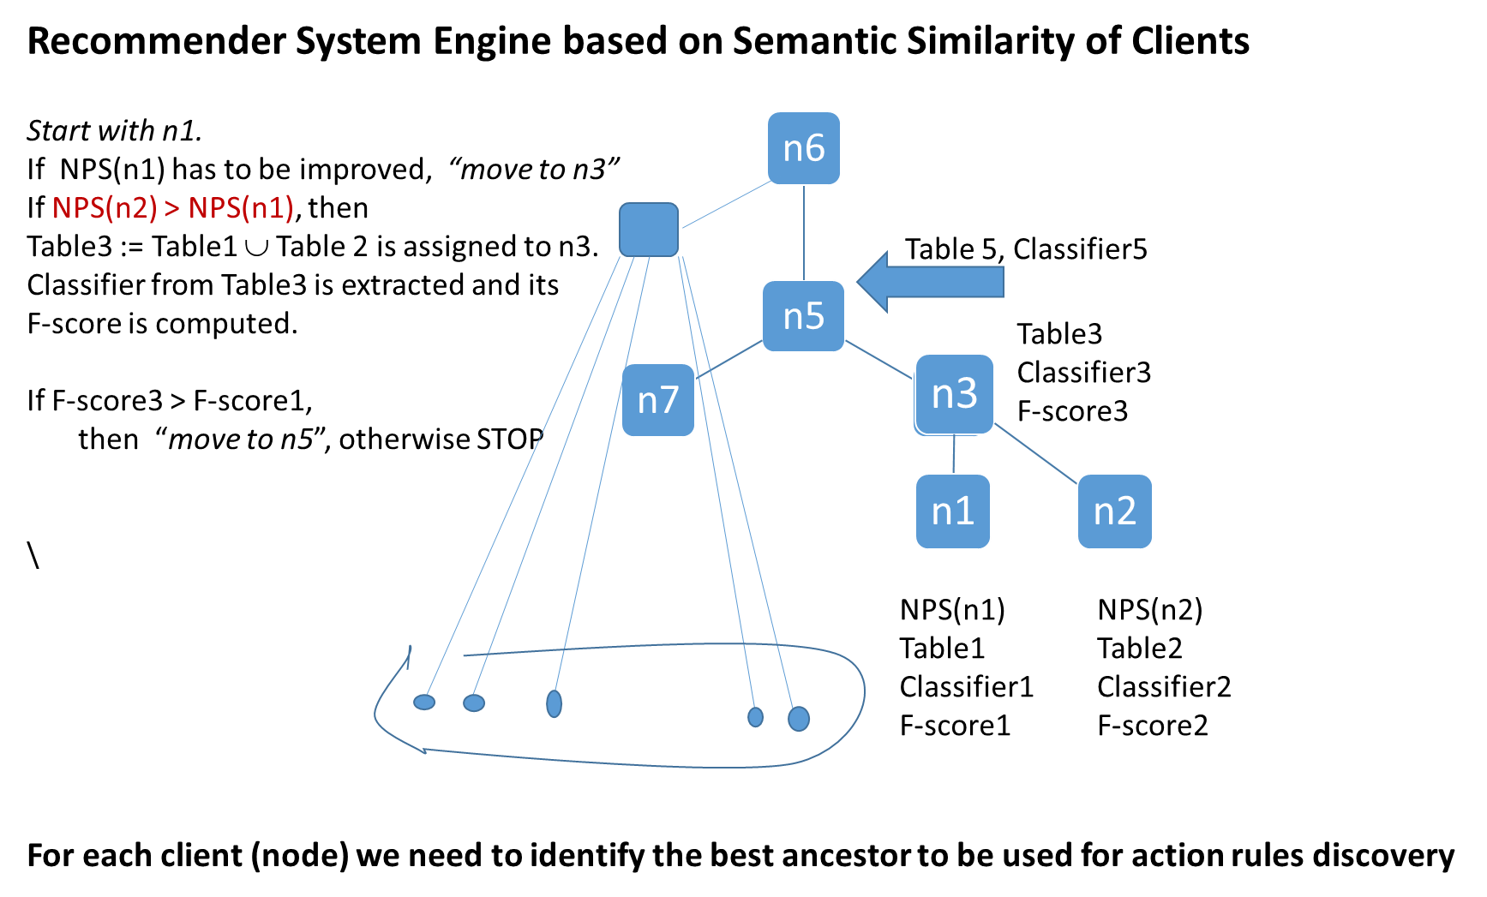

Slide 25
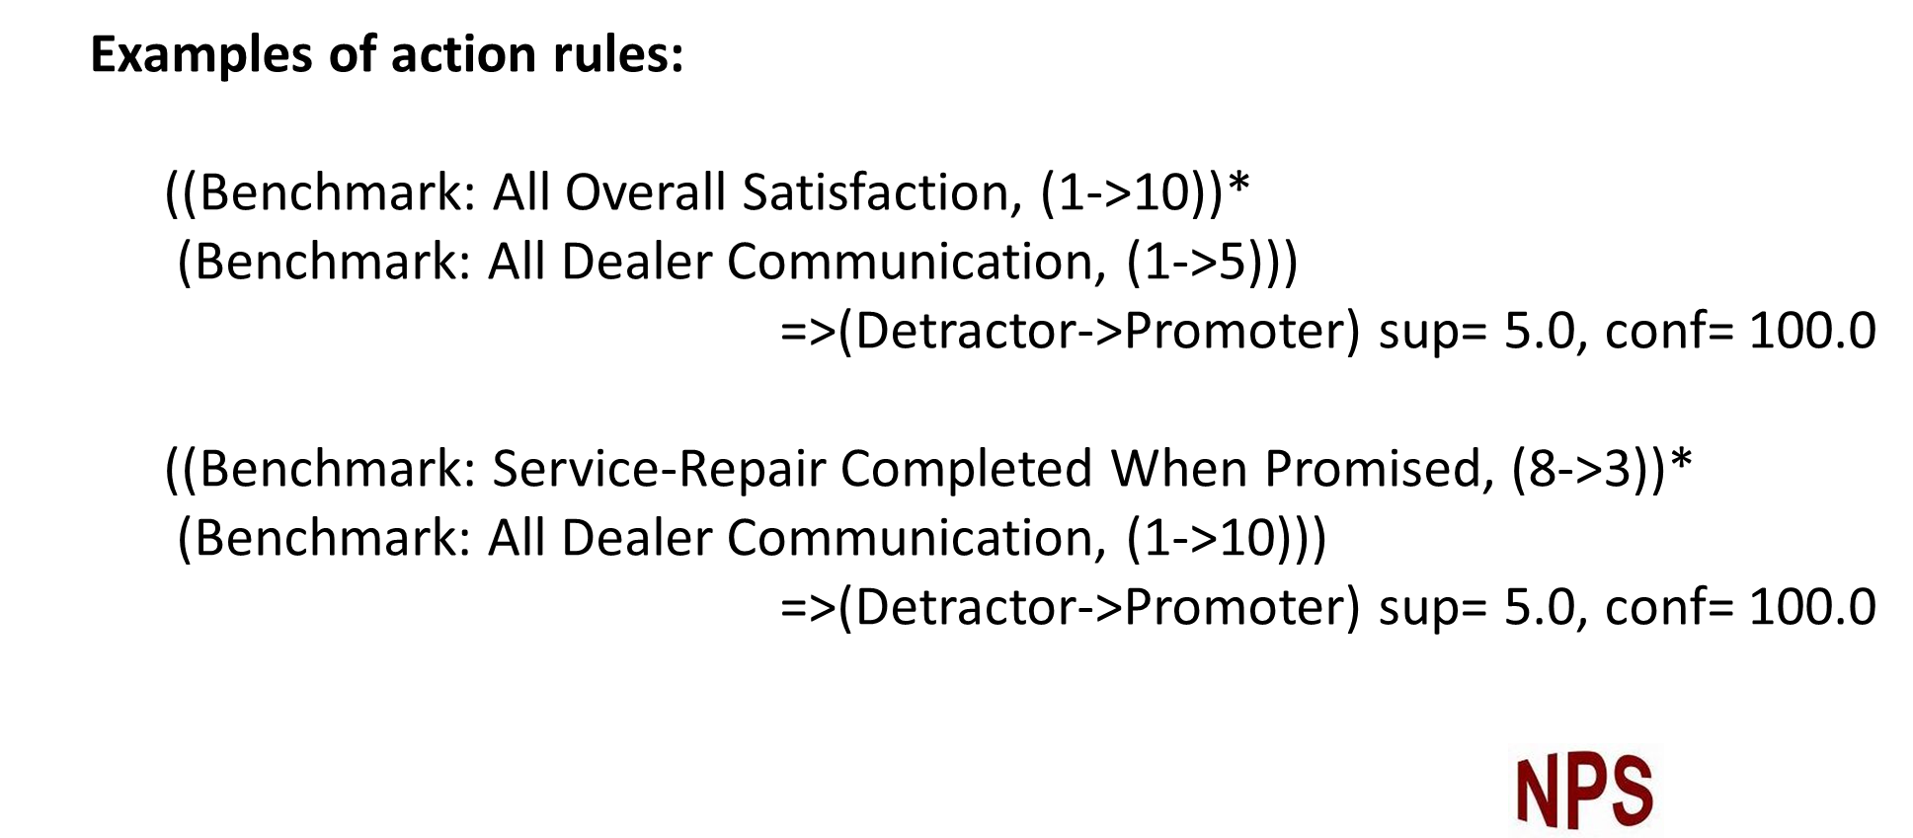
Now, from the enlarged Decision Table, we extract action rules

Slide 26
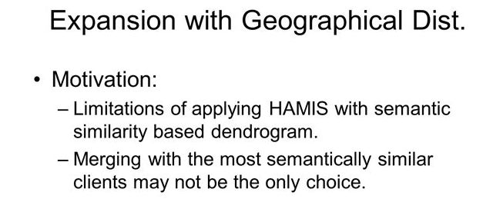
Take weighted combination of semantic & geographic distance
Now, when the dataset (decision system) is built,
we will start extracting action rules

Slide 27
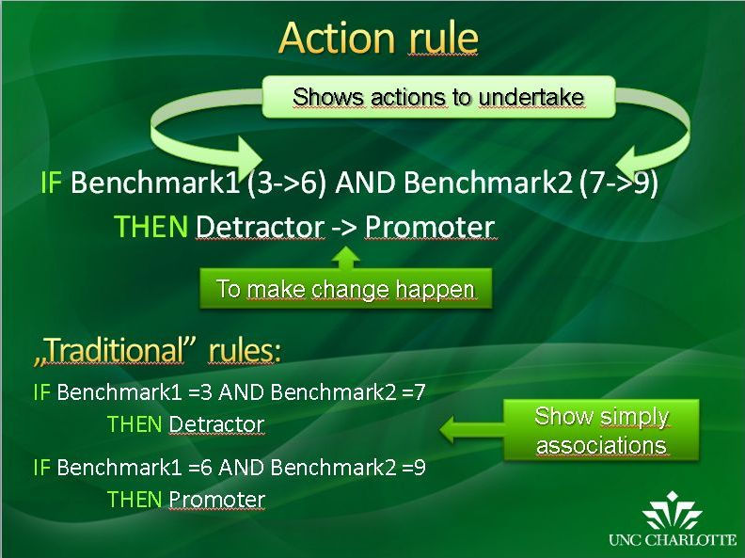
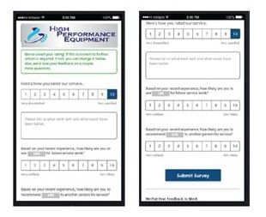

Slide 28
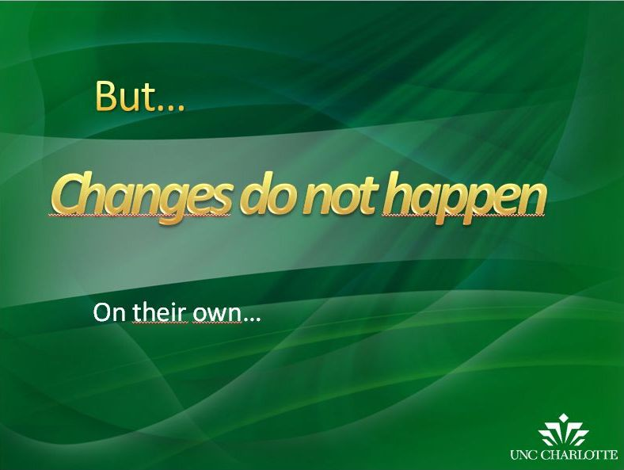

Slide 29
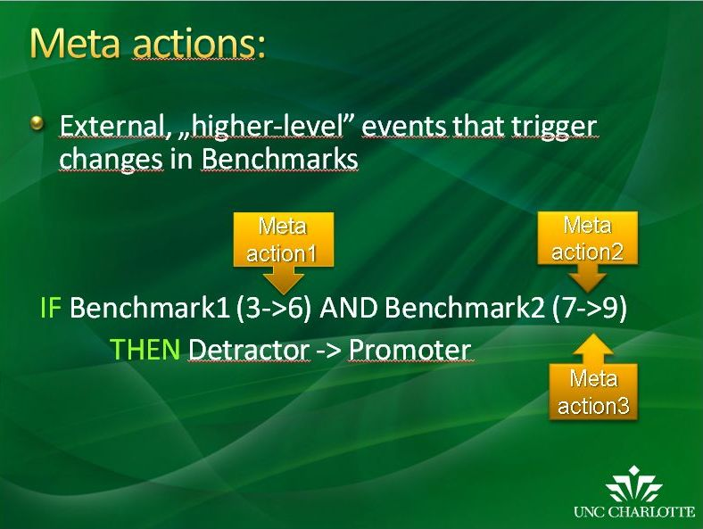

Slide 30
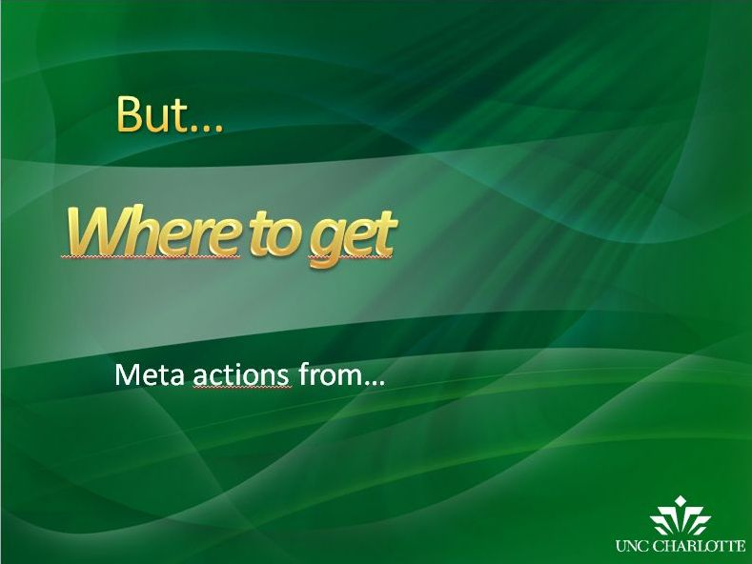

Slide 31
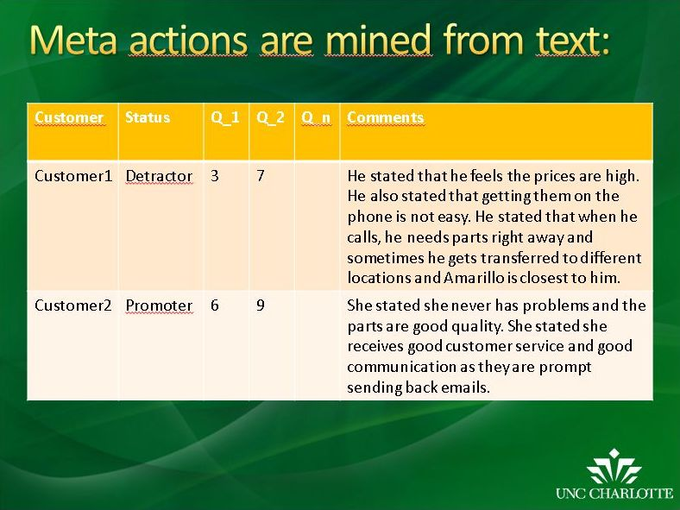

Slide 32
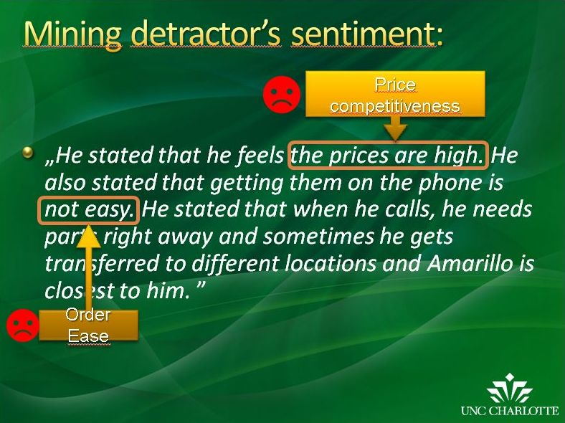

Slide 33
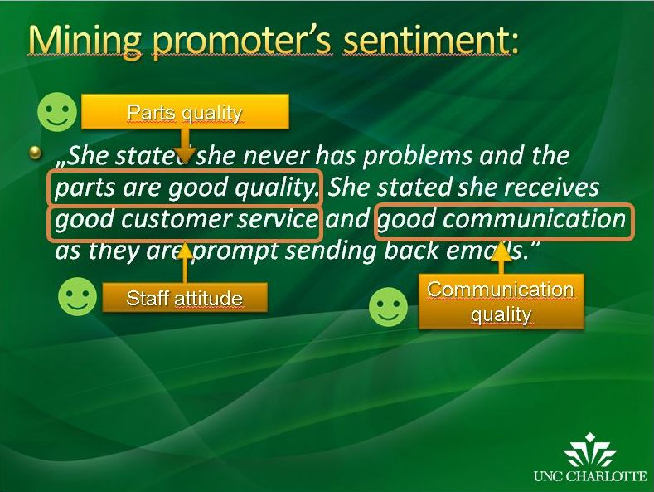

Slide 34
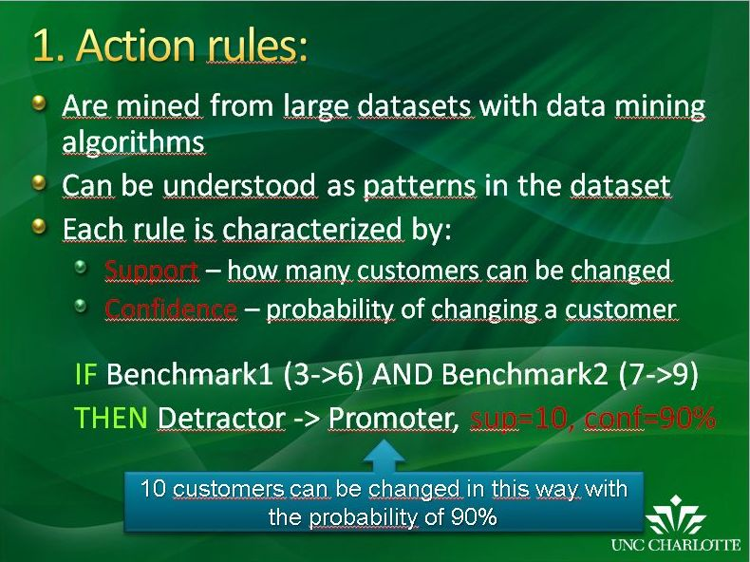

Slide 35
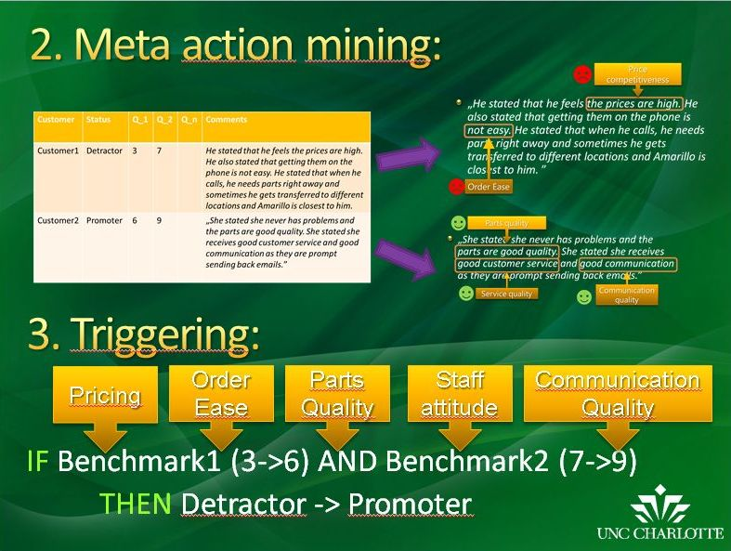

Slide 36


Extracting Meta-Actions
DATASET
Guided Folksonomy &
Sentiment Analysis
Meta-Actions
Extracting Comments
C1
C2
C3
C4
C2,C4
Knowledgeable
Staff
Customer
Bench1
Bench2
Bench3
Comments
Prom_Stat
Cust1
high
med
high
C1, C2
Prom
med
med
med
C1,C3
Friendly Staff
Cust2
C2, C3
Pass
Cust3
C1 refers to Bench2
C3 refers to Bench1
C2,C4 refers to Bench3
C4, C3
Benchmark Values ={low, medium, high}
Extracted Rules (example)
R1=[ (Bench1=high)&(Bench2=med) …………...... ⇒ (Prom_Stat = Prom)] sup(R1)={Cust1,..}; Let’s say Confidence=90%
R2=[ (Bench1=med)& ……………. (Bench3=med) ⇒ (Prom_Stat = Pass)] sup(R2)={Cust2,..}; Let’s say Confidence=95%
Action Rules
R= [(Bench1, med ->high)&(Bench2=med) ⇒ (Prom_Stat, Pass -> Prom)] Sup(R)={Cust2,..}; Confidence=90%*95%=85.5%.
Recommendation: Staff has to be more friendly (R will be activated)

Slide 37
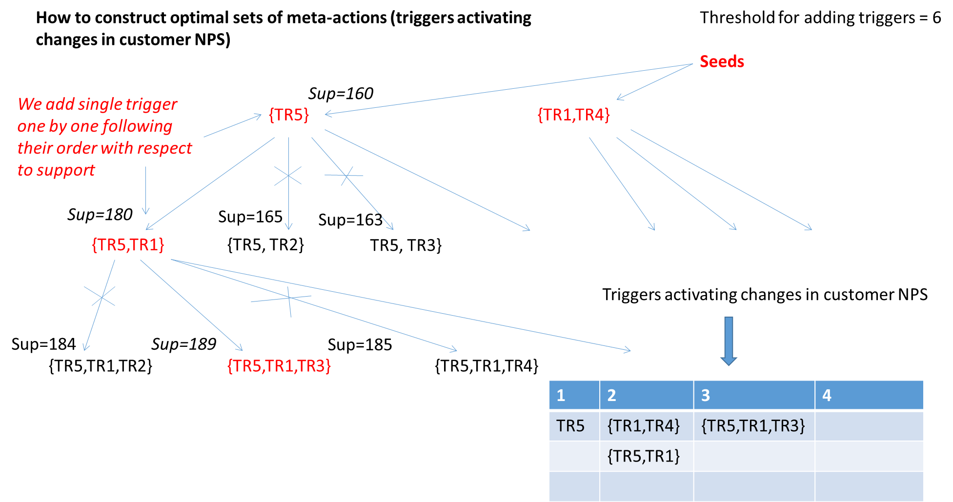

Slide 38
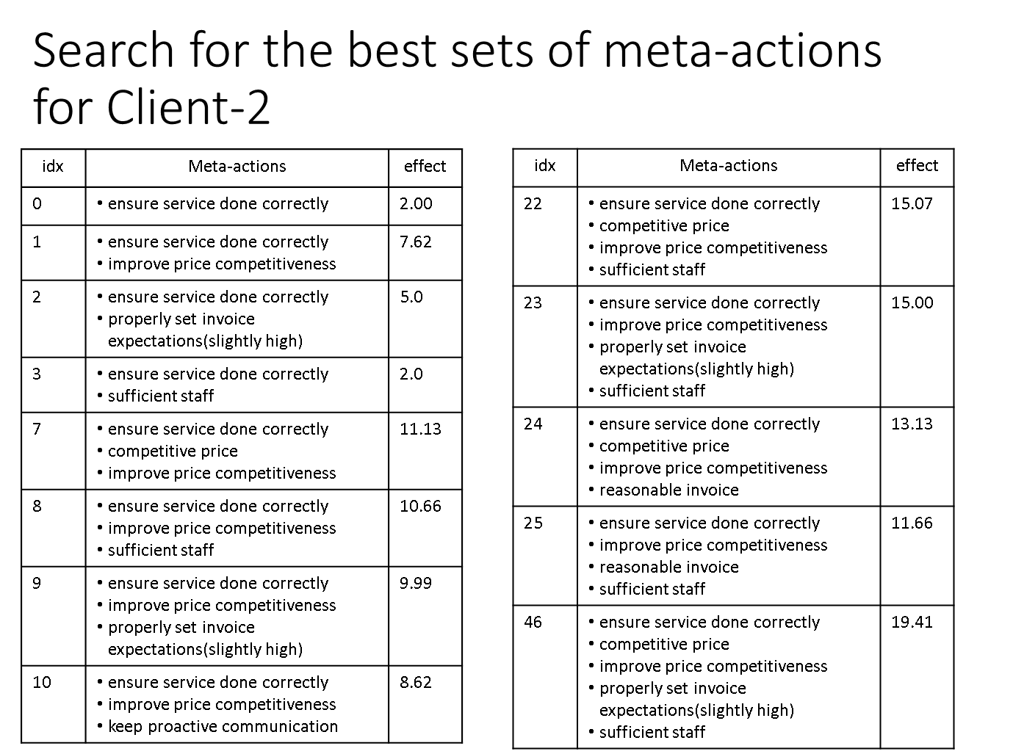

Slide 39

Recommender System

Slide 40
User-Friendly Interface

Slide 41
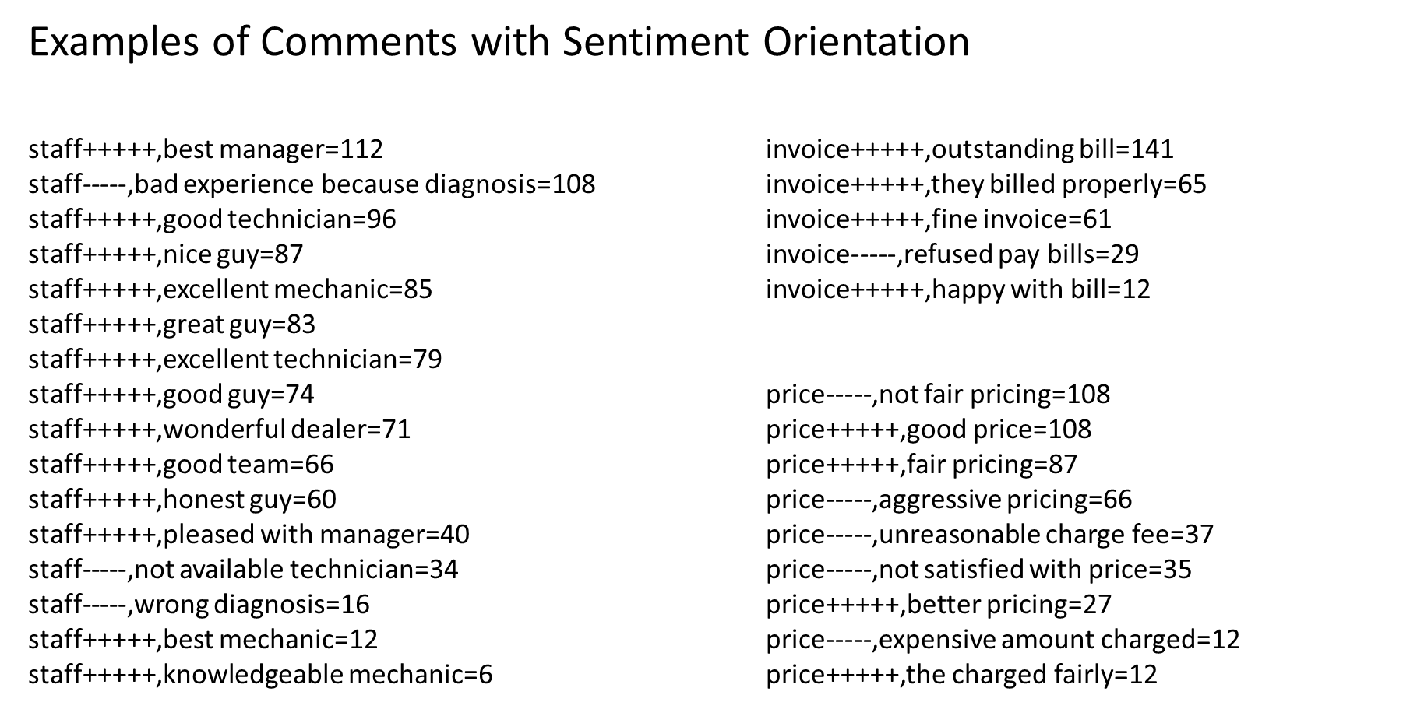

Slide 42
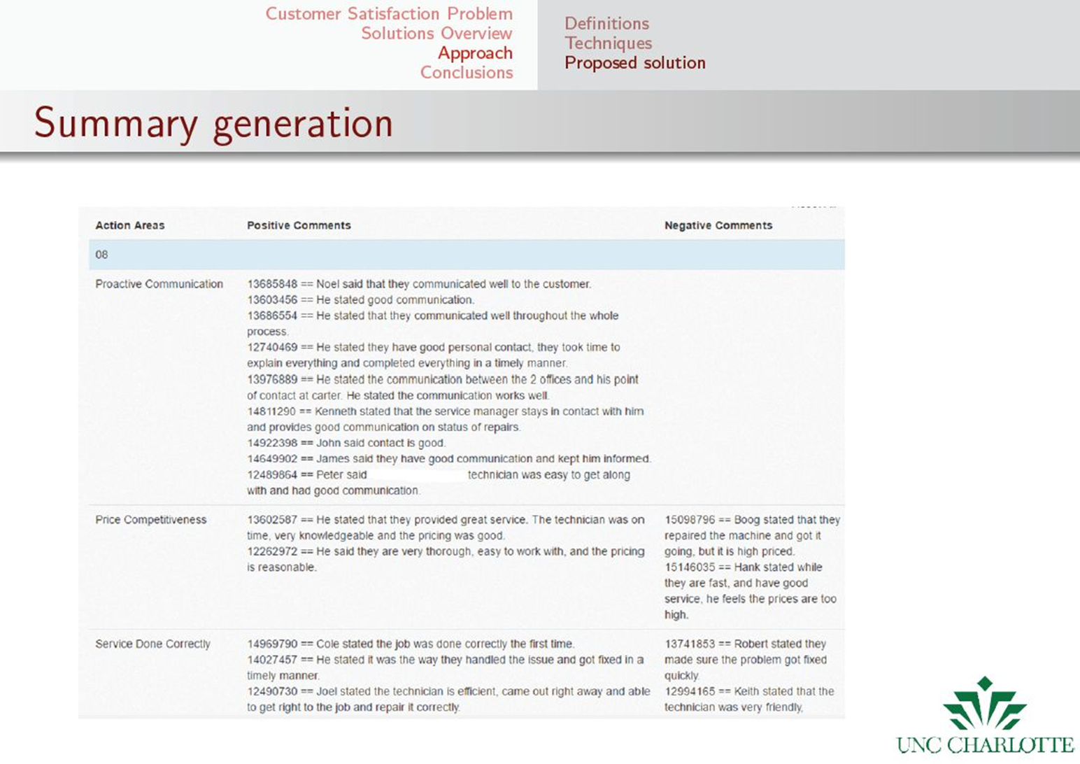

Slide 43
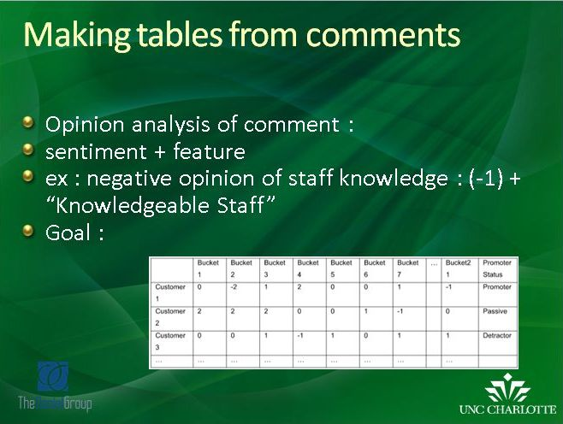

Slide 44
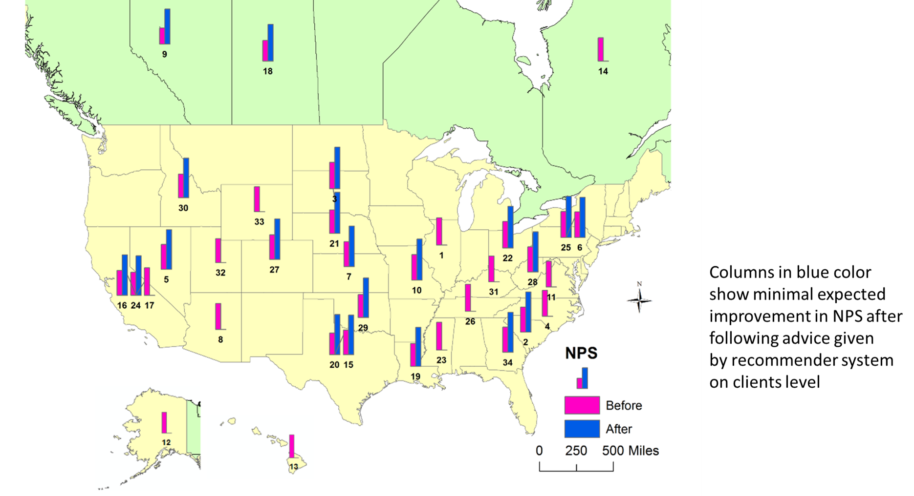
Recommender System

